Slide 1

FHA Architecture Update and Planning
December 20, 2011

Slide 2

Agenda
FHA BACKGROUND
  Overview and Initiatives
  Interoperability Architecture and FHIM Work To Date
  Challenges
FHA ARCHITECTURE PERSPECTIVES PROPOSAL
  Management Perspective
  Interoperability Perspective
FHA GOVERNANCE AND AGENCY PRIORITIES
  Governance
  Partner Priorities Known To Date
DISCUSSION AND NEXT STEPS

Slide 3
FHA BACKGROUND

Slide 4
FHA Overview
Established in 2003 as an OMB Line of Business e-Government initiative
Initial focus was identifying potential redundant investments in health IT across federal partners
Placed under ONC when it was established in 2004
Focus evolved to emphasize federal advancement of the national agenda for health IT
Scope expanded to enterprise architecture, standards adoption, tools and communication support

Slide 5
FHA Initiatives
Investment Initiatives
  Federal Health Investment Planning and Reporting (2003-2007)
Enterprise and Data Architecture
  Extending FEA for health (2003-2008)
  FHISE (2008-2010)
  FHIM (2009–Present)
  FHA Interoperability Architecture (2007-Present)
Standards Adoption
  Consolidated Health Informatics (2003-2006)
  Federal HIT Standards Adoption Workgroup (2006-2007)
  Terminology Initiative (2007)
  Federal Health IT Standards Related SDO Organizations Participation (2007-2009)
Tools
  CONNECT (2008-Present)
Communication Support (2008–Present)

Slide 6
FHA Interoperability Architecture Work To Date
Instantiated the FHA repository and populated it with available high level federal health IT information
Developed reports using FHA repository data
Worked with several partners to understand their perspectives and priorities related to FHA architecture
Developed draft scope document for FHA architecture work
Developed draft governance and architecture management processes for engaging partners in FHA architecture work
Worked with various initiatives including NIEM and S&I to leverage their work for architecture development

Slide 7
FHIM Work To Date
Information Domains Already Modeled
  Person
  Security and Privacy
  Eligibility, Enrollment, Coordination of Benefits
  Behavioral Health Assessments
  Problems
  Allergies
  Orders (General)
Information Domains Currently Being Modeled
  Lab
  Medications/Pharmacy
  Query Health information (S&I initiative)
  Public Health Reporting (S&I initiative)
Ongoing terminology modeling/value set definition work
Two prototypes to produce NIEM implementations using FHIM and MDHT

Slide 8
FHIM Work To Date
FHIM Work To Date
Ongoing work to integrate the IM Project/FHIM into the S&I Framework
  Use case requirements
  Harmonization of core concepts
  Implementation specifications
Ongoing work to support S&I Framework Initiatives
  Lab
  Transition of Care
  Query Health
  Public Health Reporting

Slide 9
FHA Challenges
Helping partners understand the collective set and value of FHA and ONC initiatives to ensure consistent utilization
Understanding and addressing partners’ health priorities
Migrating CONNECT from internal to community management
Establishing a concrete mission with specific outcomes and performance measurements
Enabling health interoperability among partners and with non-federal entities
Developing a successful engagement model for interacting with federal partners and the broader health community

Slide 10
FHA ARCHITECTURE PERSPECTIVES PROPOSAL

Slide 11
Which Challenges Do the Architecture Perspectives Address?
Challenges | Management Architecture | Interoperability Architecture
Enable partner understanding | X
Addressing health priorities |  | X
CONNECT migration | X
Establishing concrete mission | X
Enabling interoperability issues |  | X
Developing partner engagement model | X

Slide 12
Architecture Perspectives (Characteristics)
Management Architecture
Fast, cheap, lightweight
Built on top of existing assets
Outcome is not just another model
Documents FHA-related projects
  Relates to national health initiatives
  Articulates value to FHA stakeholders (partners, OMB, others)
Does not depend on having FHA governance
Interoperability Architecture
Assists partners in improving interoperability with each other and non-federal stakeholders
Focuses on both current and potential future exchanges
Provides ultimate FHA roadmap to architect and implement standards-compliant exchanges
Utilizes iterative development
  Wide and shallow first
  Depth added in subsequent iterations

Slide 13
Architecture Perspectives (Value)
Management Architecture
Understanding existing assets
Understanding assets being produced or planned for the future
Understanding roles and responsibilities for each FHA-related project
  Owners and participants
  Schedule and milestones
  Artifacts
  Performance metrics
  Alignment to key national health initiatives
    Meaningful Use
    S&I initiatives
    Agency initiatives – VLER, SSA LTD, CMS, etc.
Interoperability Architecture
Facilitate reuse of exchanges that have been developed
Move to standards based interoperability
  Increases exchange accuracy
  Improves development process
  Enables cost efficient decisions
  Shortens timelines
Coordinating federal strategies

Slide 14
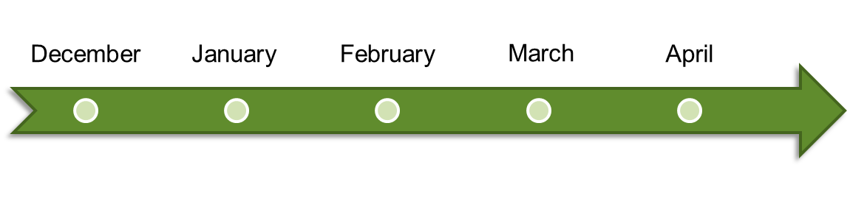



Architecture Perspectives Plan
Management
Architecture
FHA Architecture
Governance
Interoperability
Architecture
Iterative Development
FHIM
Iterative Development

Slide 15
Management Architecture Summary
Benefit to stakeholders
  Relates FHA to national healthcare initiatives and strategic agency priorities
  Provides summary view of the collective set of FHA initiatives
  Enables common understanding for the development of Interoperability Architecture
Deliverables
  Document(s) summarizing FHA assets, projects, uses and relationships
  FHA repository to reflect relevant Management Architecture information
  FHA repository reports summarizing core Management Architecture information
Major Management Architecture deliverables will be completed by the end of February 2012
Management Architecture consists of:
  3 FTE core team for 10 weeks
  Additional SME consulting as needed

Slide 16






Management Architecture Plan
1. Agree on relevant data set for Management Architecture
2. Collect and validate data on FHA projects
3. Relate FHA projects to federal initiatives
4. Enhance FHA repository and write reports
5. Create Management Architecture document

Slide 17
How does Management Architecture Enable Interoperability Architecture Development?
Facilitates FHA strategic planning
Summarizes ongoing initiatives and level sets the stakeholders’ understanding of the federal health IT space
Identifies FHA projects that support the development of Interoperability Architecture
Assists in developing the governance necessary for Interoperability Architecture

Slide 18
Interoperability Architecture Summary
Benefit to stakeholders
  Enables understanding and improvement of health interoperability between stakeholders
  Addresses partners’ health priorities
  Enables federal strategic planning for Health IT
  Advances standards-based information exchange by producing a harmonized set of information, terminologies and value sets
  Provides a harmonized information model that can be leveraged by federal partners to create internal databases that are consistent with information standards
  Provides integrated, model-based tools to assist federal partners in developing instance implementations of information exchange standards

Slide 19
Interoperability Architecture Summary
Deliverables (after each iteration)
  Document(s) summarizing existing exchanges and future recommended exchanges including:
    Business Architecture – business processes supported
    Information Architecture – data sets exchanged and applicable standards
    Systems architecture – source and target systems, and applicable interfaces
  FHA repository to reflect relevant exchanges and information about them
  FHA repository reports summarizing relevant information about exchanges
  Harmonized UML model of the FHIM information domain(s) modeled
  Spreadsheet of FHIM information concepts for the information domain(s) modeled
  Spreadsheet mapping existing standards to the FHIM information domain(s) modeled
Interoperability Architecture deliverables will be completed by the end of each iteration
Interoperability Architecture consists of:
  4 FTE core team for 3 months per iteration
  Additional SME consulting as needed

Slide 20
FHIM Support for Interoperability Architecture
Finish modeling a core set of information domains (approximately 15 information domains)
Model terminologies/value sets to support the core set of information domains
Fully integrate the models (FHIM and associated terminologies/value sets) with the Model Driven Health Tools (MDHT)
From the models and MDHT, generate information exchange implementation standards that support XML-based exchanges of documents and messages
Leverage the models and MDHT to assist partners with implementing the information exchange implementation standards

Slide 21





Example of Exchange Analysis
Federal
Other – state, local,
commercial
CMS
Paper
CDC
Paper
VA
HL7 v2
Non -
Federal
DHS
DoD
Paper
Business Architecture – business use cases, processes, requirements supported
Information Architecture – information, terminologies, value sets exchanged and applicable standards
Systems Architecture – source and target systems, information exchange standards
Paper-based exchanges or standards such as HL7 v2
Current exchange
Supported by a variety of models and tools
Standards compliant, XML-based
Future exchange
messages and documents with common transport

Slide 22
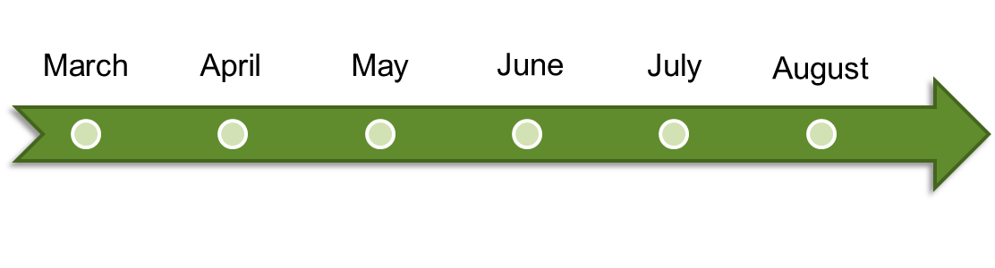






Interoperability Architecture Plan
ITERATION 1
1.1 AS-IS Architecture
1.2 TO-BE Architecture
1.3 Roadmap
ITERATION 2
2.1 AS-IS Architecture
2.2 TO-BE Architecture
2.3 Roadmap
ADDITIONAL ITERATIONS

Slide 23
FHA GOVERNANCE AND AGENCY PRIORITIES

Slide 24

FHA Governance Structure
Proposal for a new structure
that would:
  Align with original FHA governance model
  Create more strategic focus and direction
  Streamline board structure
  Continue to provide venue for Federal agency participation and input
  Enable funding partners to more
  effectively provide programmatic
  guidance and direction

Slide 25


Federal Health Architecture (FHA) –
Proposed Governance Model
FHA Governing Board
Strategic Direction and Oversight
FHA Managing Board
FHA Advisory Board
Planning and Management
Architecture & Modeling Workgroup
Collaborative cross-agency work on specific areas of FHA focus
Data Exchange & Interoperability Workgroup
Communication & Coordination
Workgroup

Slide 26
FHA Governance – Technical Workgroups
Build out Federal Health Interoperability Architecture in priority areas
Facilitate collaboration across Federal health partners in aligning health architectures
Align the Federal Health Information Model with the S&I Framework
Align with Health Domain and NEIM
Architecture & Modeling
Develop overarching strategy and plan for data exchange and interoperability initiatives across partners and with private partners
Initiate collaborative efforts in priority areas
Align data exchange and interoperability initiatives with the S&I framework
Develop transition plan for moving CONNECT to open source, distributed development model
Data Exchange & Interoperability
Federal health investment planning and reporting
Interagency agreements
Communications and outreach on Federal health initiatives
Communication & Coordination
*Standing or ad-hoc Workgroups, as identified, recommended by Managing Board and approved by Governing Board

Slide 27
FHA Partner Priorities Known To Date
HHS
  Reuse of HHS EA repository
  NIEM conformance of artifacts and instantiation of NIEM health domain
  Leveraging of existing ONC and HHS initiative products
  “Middle-out” architecture
DoD
  Validation and reuse of business reference model
  Validation of FHIM and reference implementation development
  Map and gap missing terminology and standards
  Effective FHA architecture governance
  Create good FHA repository
VA
  Top-down approach for definition of FHA use, scope, processes, data, and services
  Common business reference model
  Reuse of the work already done between VA and DoD
  Common repository to store information

Slide 28
FHA Partner Priorities Known To Date
CMS
  Focus on future-oriented activities rather than legacy exchanges
  Inclusion EHR business processes and data exchanges
  Focus on reusable services due to budgetary constraints and needs to be more efficient
SSA
  Concern regarding the value of FHA architecture when balanced against limited resources
  Desire to reuse the work done by DoD, VA, and other partners
  Desire to revisit SSA models from prior activities related to HIT initiatives before committing to new contributions on FHA architecture

Slide 29
Discussion and Next Steps
Plan for facilitating the partner meeting on 12/20
Obtain partner buy-in
Continue work on Management Architecture
Operationalize FHA governance
Refine partner priorities

Slide 30
APPENDIX

Slide 31








What’s the FHA Value Proposition?
Health IT interoperability:
    Artifacts that are a means to achieve interoperability (primarily for federal partners, but available to non-federal parties as well)
FHA PMO efficiently managing FHA:
    Establishing and maintaining a governance structure ensuring that work is prioritized, artifacts are delivered and their use is promoted
Other
S&I Exchanges
Other Federal
Other ONC
Agency-Non Agency
Exchanges
FHA S&I
FHA PMO
Inter-agency Exchanges
Management Architecture
Interoperability Architecture

Slide 32
Interoperability Artifacts and Their Value
Specifications of exchanges
  Helps the implementation of interoperability
Strict definitions of the data entities and terminology used in the exchanges
  Helps the implementation of exchange specifications (FHIM, NIEM, other)
Context where each specification apply (data mapped to process, i.e. use case)
  Helps assess the impact of new priorities
  Helps the selection and implementation of exchange specifications
Software to implement exchanges
  Helps enabling interoperability
Map of current health exchanges (As-Is) (organization and systems)
  Helps identify new priorities (by showing gaps)
  Helps assess the impact of new or changed health priorities
Map of future state (To-Be)
  Helps manage initiatives
  Helps identify new priorities (by showing gaps)
Training on the use of specifications and software
  Helps the selection and implementation of exchange specifications

